Slide 1
SCS 3253 Term Project
Airbnb Property Price Prediction in Toronto
Howell Wang,
Leila Cristina Fidelino,
Janice Cheung
April 7, 2020

Slide 2
Purpose / Procedure
Clean and analyze Airbnb dataset for Toronto scraped in February 2020
Predict the housing prices in Toronto through Airbnb data
Prepare data for machine learning algorithms
Train dataset using a variety of different models
Evaluate model performance

Slide 3
Dataset Information
Airbnb data for Toronto scraped in Feb 2020 was obtained from http://insideairbnb.com/get-the-data.html in .csv format
Dataset contained 23,398 entries and 106 attributes
76 attributes (unrelated to price) were removed
30 attributes were kept for initial data cleaning and analysis

Slide 4
Data Cleaning and Visualization
Removed ‘$’ on columns with amounts
Cleaned up ‘zipcode’ attribute to contain one of the 9 areas (M1 to M9)
Changed ‘neighbourhood_listing_total’ attribute from categorical to numerical
Grouped categories within the ‘property_type’ attribute
Created a new feature called ‘amenities_score’ to address the 21,883 unique values in the ‘amenities’ attribute
A correlation heatmap was created to check correlation between categorical features. Further attributes which did not meet threshold were removed

Slide 5
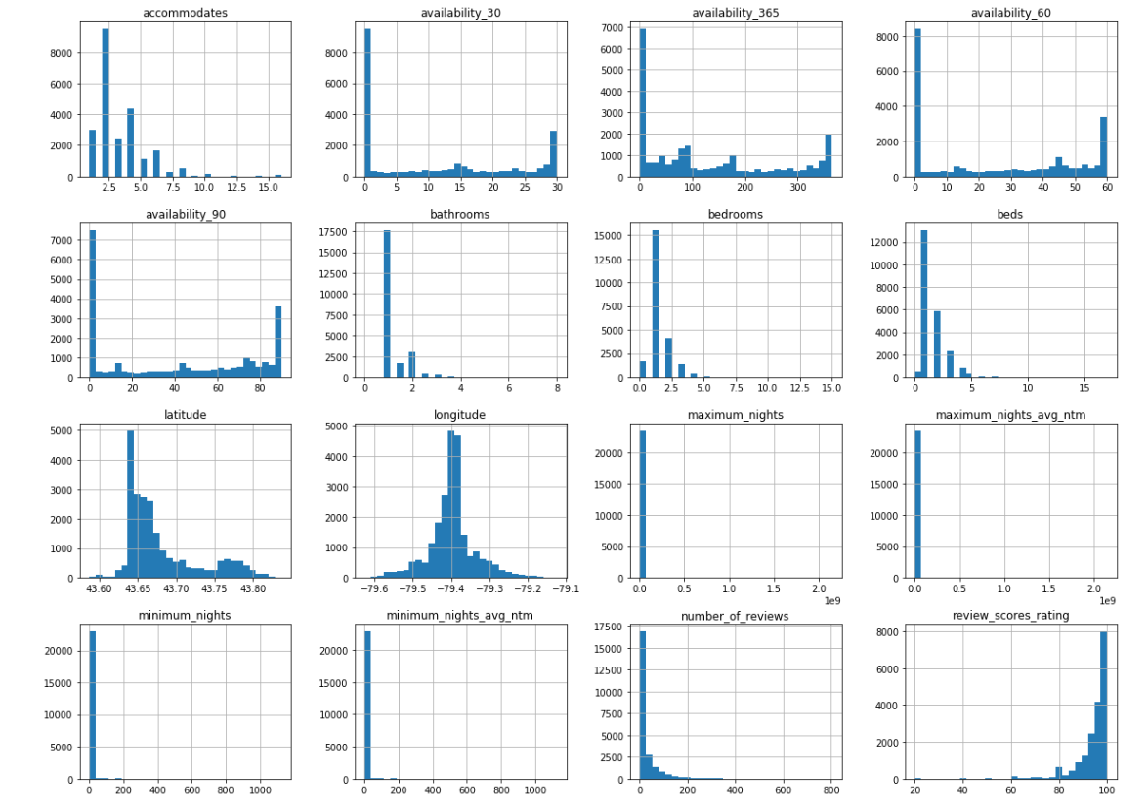
Data Visualization - Histogram of Attributes

Slide 6
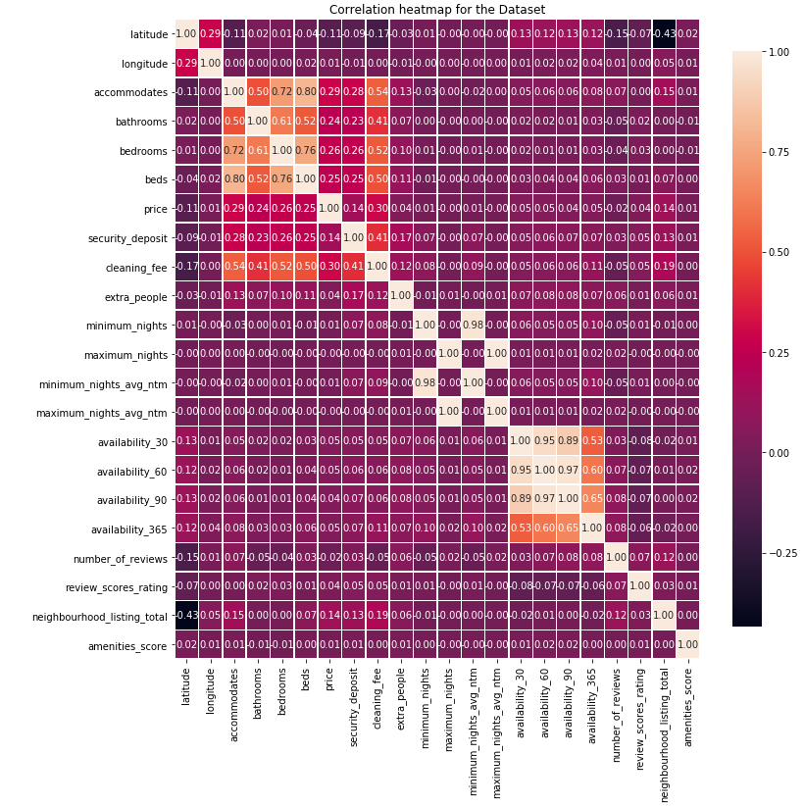
Data Visualization - Correlation Heatmap
Additional attributes that did not meet threshold were dropped:
bedrooms
beds
minimum_nights_avg_ntm
maximum_nights_avg_ntm
availability_60
availability_90

Slide 7
Data Preparation for Machine Learning Algorithms
Final dataset used for training consisted 25 attributes
Train and test sets were created (0.7 : 0.3 ratio)
ColumnTransformer was used to apply transformations to each feature
Numerical features were standardized using StandardScaler and corrected for null values using SimpleImputer (strategy = “Median”)
Categorical features were transformed using OneHotEncoder

Slide 8
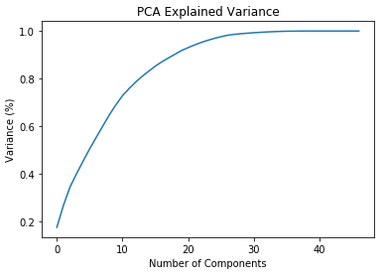
Dimensionality Reduction using PCA
Additional 2 dimensions were reduced using PCA (n_components = 0.95)
Reconstruction loss was 2.1% and 4.8% variance was lost

Slide 9
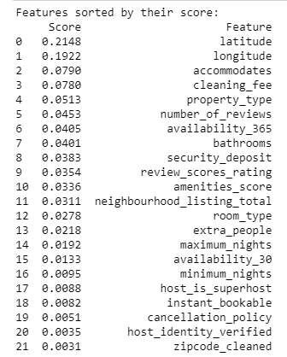
Rank Features Using RandomForestRegressor

Slide 10
Model Training Summary
Models | MAE | RMSE | R2
LinearRegression | 61.5436 | 205.2546 | 0.1453
Lasso | 60.5041 | 205.1665 | 0.1461
Ridge | 61.5425 | 205.2544 | 0.1453
RandomForestRegressor | 62.4693 | 217.6150 | 0.0393
ElasticNet | 59.4998 | 205.3499 | 0.1445
SVR(gamma = ‘auto’) | 53.7914 | 212.0717 | 0.0876
SVR(kernel = ‘poly’, degree = 2) | 62.3936 | 215.1652 | 0.0608
XGBRegressor | 59.3522 | 212.3718 | 0.0850

Slide 11
Grid Search for Elastic Net
‘Alpha’ : 0.001
‘L1_ratio’ : 0.2
Best score = 252.0602
Apply above hyperparameter values on test set
RMSE : 204.6953
MAE : 60.8519

Slide 12
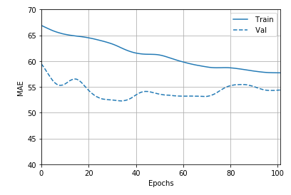
Neural Networks
Constructed using 2 Dense layers of size 64, followed by dropout layer.
RELU activation function
RMSProp optimizer with learning rate of (0.018)
Result:
loss: 46631.7685
mae: 54.7595
mse: 46631.7734

Slide 13
Conclusion / Findings
The top features that contribute to a higher AirBnb pricing is latitude/longitude, accommodates, cleaning_fee and property_type. This makes intuitive sense because the location of the property, how many people it can accommodates, the amount of money it requires for cleanup, and the type of the property can have a big impact on the price of the Airbnb listing.
Based on all the models, Neural Network model has the lowest error. This model can continue to be tweaked via adjusting parameters such as the layers, learning rate, optimizers, etc.

